Slide 1
Decision Support and Business Intelligence Systems
(9th Ed., Prentice Hall)
Chapter 12:
Artificial Intelligence and Expert Systems

Slide 2
Learning Objectives
Understand the basic concepts and definitions of artificial intelligence (AI)
Become familiar with the AI field and its evolution
Understand and appreciate the importance of knowledge in decision support
Become accounted with the concepts and evolution of rule-based expert systems (ES)
Understand the general architecture of rule-based expert systems
Learn the knowledge engineering process, a systematic way to build ES

Slide 3
Learning Objectives
Learn the benefits, limitations and critical success factors of rule-based expert systems for decision support
Become familiar with proper applications of ES
Learn the synergy between Web and rule-based expert systems within the context of DSS
Learn about tools and technologies for developing rule-based DSS
Develop familiarity with an expert system development environment via hands-on exercises

Slide 4

Opening Vignette:
“A Web-based Expert System for Wine Selection”
Company background
Problem description
Proposed solution
Results
Answer and discuss the case questions

Slide 5
Artificial Intelligence (AI)
Artificial intelligence (AI)
  A subfield of computer science, concerned with symbolic reasoning and problem solving
AI has many definitions…
  Behavior by a machine that, if performed by a human being, would be considered intelligent
  “…study of how to make computers do things at which, at the moment, people are better
  Theory of how the human mind works

Slide 6
AI Objectives
Make machines smarter (primary goal)
Understand what intelligence is
Make machines more intelligent and useful
Signs of intelligence…
  Learn or understand from experience
  Make sense out of ambiguous situations
  Respond quickly to new situations
  Use reasoning to solve problems
  Apply knowledge to manipulate the environment

Slide 7
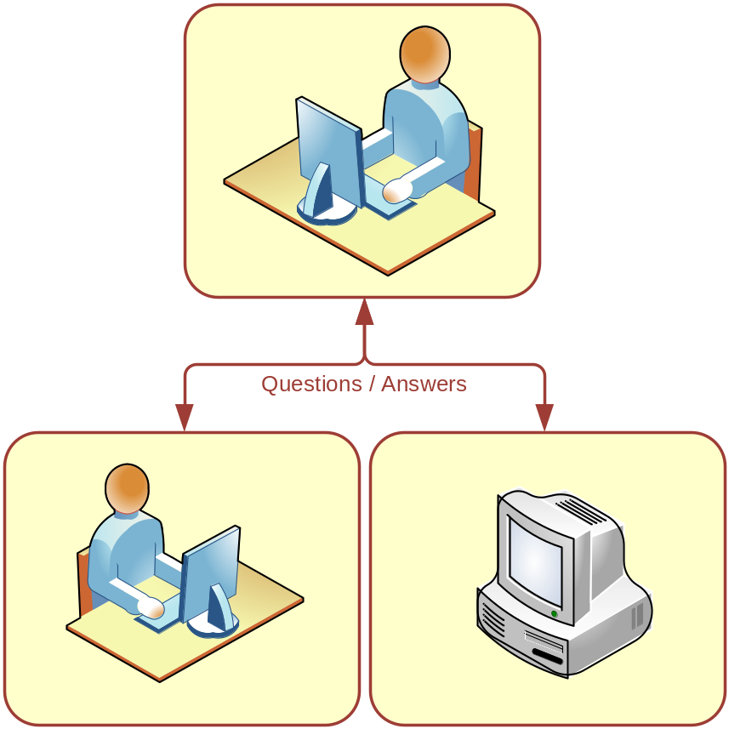
Test for Intelligence
Turing Test for Intelligence
A computer can be considered to be smart only when a human interviewer, “conversing” with both an unseen human being and an unseen computer, can not determine which is which.
- Alan Turing

Slide 8
Symbolic Processing
AI …
  represents knowledge as a set of symbols, and
  uses these symbols to represent problems, and
  apply various strategies and rules to manipulate symbols to solve problems
A symbol is a string of characters that stands for some real-world concept (e.g., Product, consumer,…)
Examples:
  (DEFECTIVE product)
  (LEASED-BY product customer) - LISP
  Tastes_Good (chocolate)

Slide 9
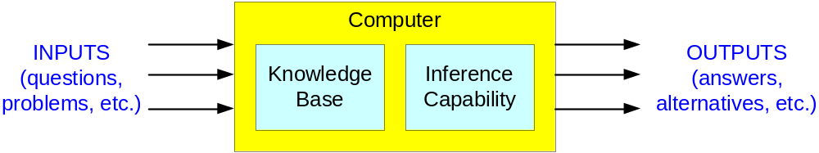
AI Concepts
Reasoning
  Inferencing from facts and rules using heuristics or other search approaches
Pattern Matching
  Attempt to describe and match objects, events, or processes in terms of their qualitative features and logical and computational relationships
Knowledge Base

Slide 10
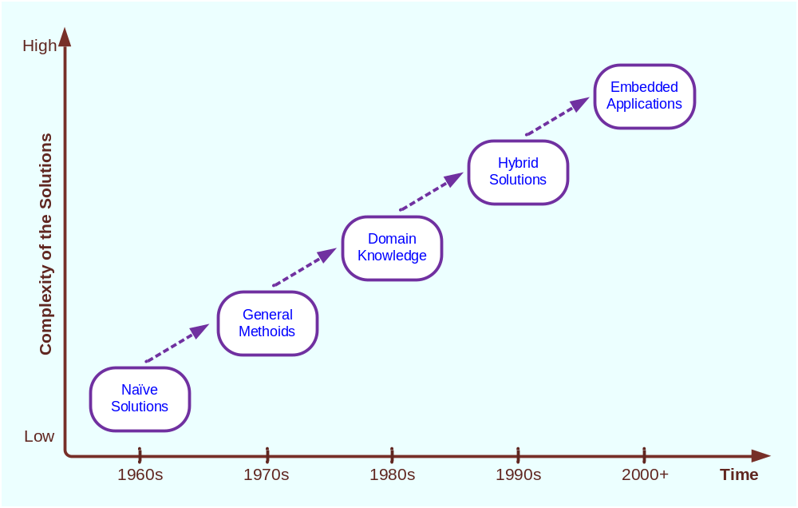
Evolution of artificial intelligence

Slide 11
Artificial vs. Natural Intelligence
Advantages of AI
  More permanent
  Ease of duplication and dissemination
  Less expensive
  Consistent and thorough
  Can be documented
  Can execute certain tasks much faster
  Can perform certain tasks better than many people
Advantages of Biological Natural Intelligence
  Is truly creative
  Can use sensory input directly and creatively
  Can apply experience in different situations

Slide 12
The AI Field
AI is many different sciences and technologies
It is a collection of concepts and ideas
  Linguistics
  Psychology
  Philosophy
  Computer Science
  Electrical Engineering
  Mechanics
  Hydraulics
  Physics
  Optics
  Management and Organization Theory
  Chemistry
  Chemistry
  Physics
  Statistics
  Mathematics
  Management Science
  Management Information Systems
  Computer hardware and software
  Commercial, Government and Military Organizations
  …

Slide 13
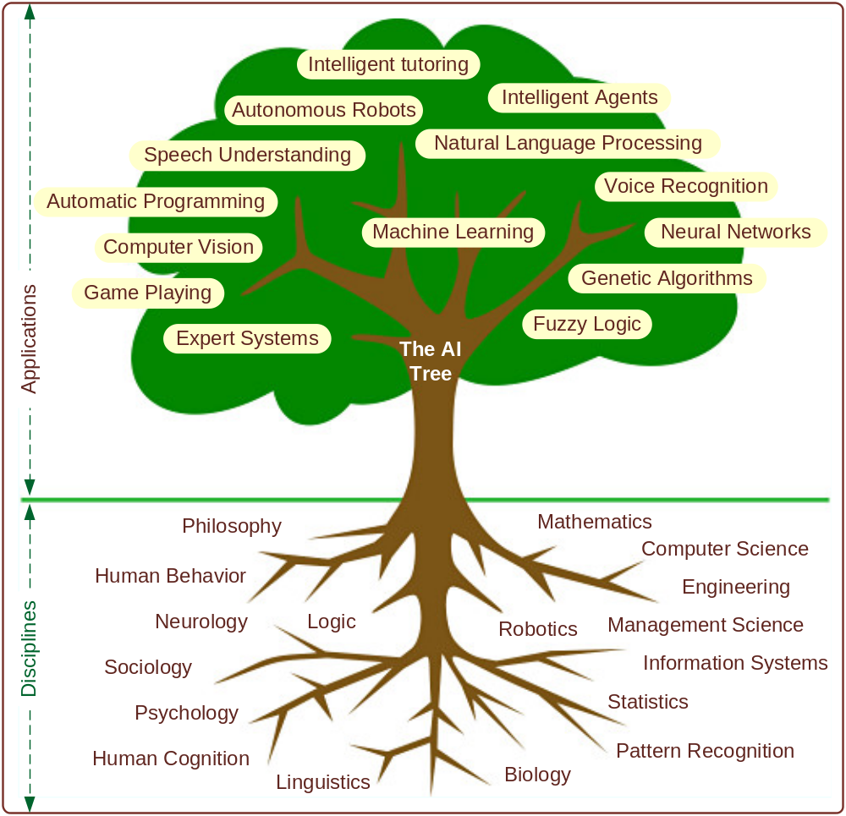
The AI Field…
AI provides the scientific foundation for many commercial technologies

Slide 14
AI Areas
Major…
  Expert Systems
  Natural Language Processing
  Speech Understanding
  Robotics and Sensory Systems
  Computer Vision and Scene Recognition
  Intelligent Computer-Aided Instruction
  Automated Programming
  Neural Computing Game Playing
Additional…
  Game Playing, Language Translation
  Fuzzy Logic, Genetic Algorithms
  Intelligent Software Agents

Slide 15
AI is often transparent in many commercial products
Anti-lock Braking Systems (ABS)
Automatic Transmissions
Video Camcorders
Appliances
  Washers, Toasters, Stoves
Help Desk Software
Subway Control…

Slide 16

Expert Systems (ES)
Is a computer program that attempts to imitate expert’s reasoning processes and knowledge in solving specific problems
Most Popular Applied AI Technology
  Enhance Productivity
  Augment Work Forces
Works best with narrow problem areas/tasks
Expert systems do not replace experts, but
  Make their knowledge and experience more widely available, and thus
  Permit non-experts to work better

Slide 17


Important Concepts in ES
Expert
A human being who has developed a high level of proficiency in making judgments in a specific domain
Expertise
  The set of capabilities that underlines the performance of human experts, including
    extensive domain knowledge,
    heuristic rules that simplify and improve approaches to problem solving,
    meta-knowledge and meta-cognition, and
    compiled forms of behavior that afford great economy in a skilled performance

Slide 18

Important Concepts in ES
Experts
  Degrees or levels of expertise
  Nonexperts outnumber experts often by 100 to 1
Transferring Expertise
  From expert to computer to nonexperts via acquisition, representation, inferencing, transfer
Inferencing
  Knowledge = Facts + Procedures (Rules)
  Reasoning/thinking performed by a computer
Rules (IF … THEN …)
Explanation Capability (Why? How?)

Slide 19
Applications of Expert Systems
DENDRAL
  Applied knowledge (i.e., rule-based reasoning)
  Deduced likely molecular structure of compounds
MYCIN
  A rule-based expert system
  Used for diagnosing and treating bacterial infections
XCON
  A rule-based expert system
  Used to determine the optimal information systems configuration
New applications: Credit analysis, Marketing, Finance, Manufacturing, Human resources, Science and Engineering, Education, …

Slide 20
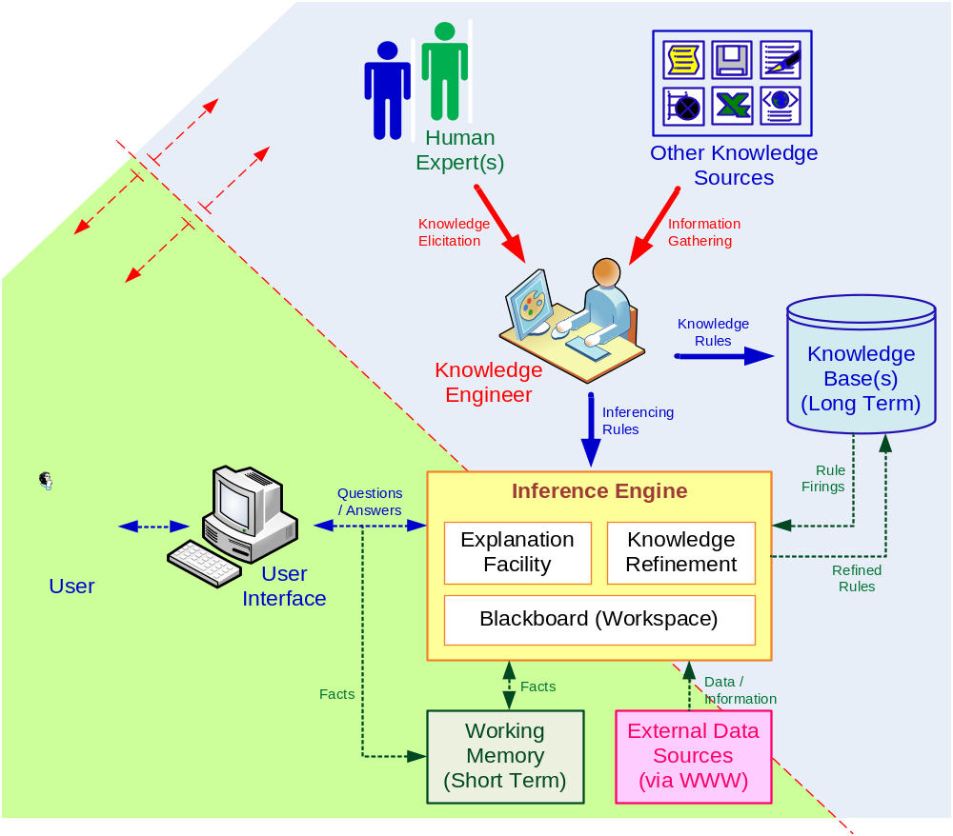
Structures of Expert Systems
Development Environment
Consultation (Runtime) Environment

Slide 21
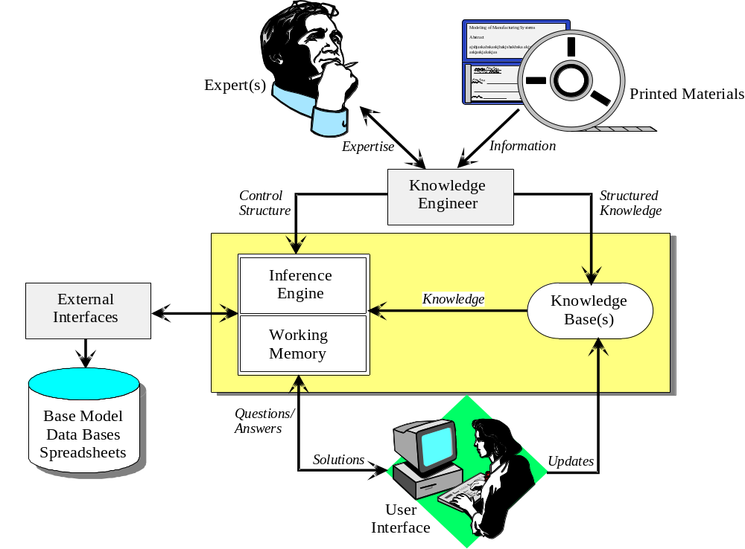
Conceptual Architecture of a Typical Expert Systems

Slide 22
The Human Element in ES
Expert
  Has the special knowledge, judgment, experience and methods to give advice and solve problems
Knowledge Engineer
  Helps the expert(s) structure the problem area by interpreting and integrating human answers to questions, drawing analogies, posing counter examples, and enlightening conceptual difficulties
User
Others
  System Analyst, Builder, Support Staff, …

Slide 23
Structure of ES
Three major components in ES are:
  Knowledge base
  Inference engine
  User interface
ES may also contain:
  Knowledge acquisition subsystem
  Blackboard (workplace)
  Explanation subsystem (justifier)
  Knowledge refining system

Slide 24
Structure of ES
Knowledge acquisition (KA)
The extraction and formulation of knowledge derived from various sources, especially from experts (elicitation)
Knowledge base
A collection of facts, rules, and procedures organized into schemas. The assembly of all the information and knowledge about a specific field of interest
Blackboard (working memory)
An area of working memory set aside for the description of a current problem and for recording intermediate results in an expert system
Explanation subsystem (justifier)
The component of an expert system that can explain the system’s reasoning and justify its conclusions

Slide 25
Knowledge Engineering (KE)
A set of intensive activities encompassing the acquisition of knowledge from human experts (and other information sources) and converting this knowledge into a repository (commonly called a knowledge base)
The primary goal of KE is
  to help experts articulate how they do what they do, and
  to document this knowledge in a reusable form
Narrow versus Broad definition of KE?

Slide 26
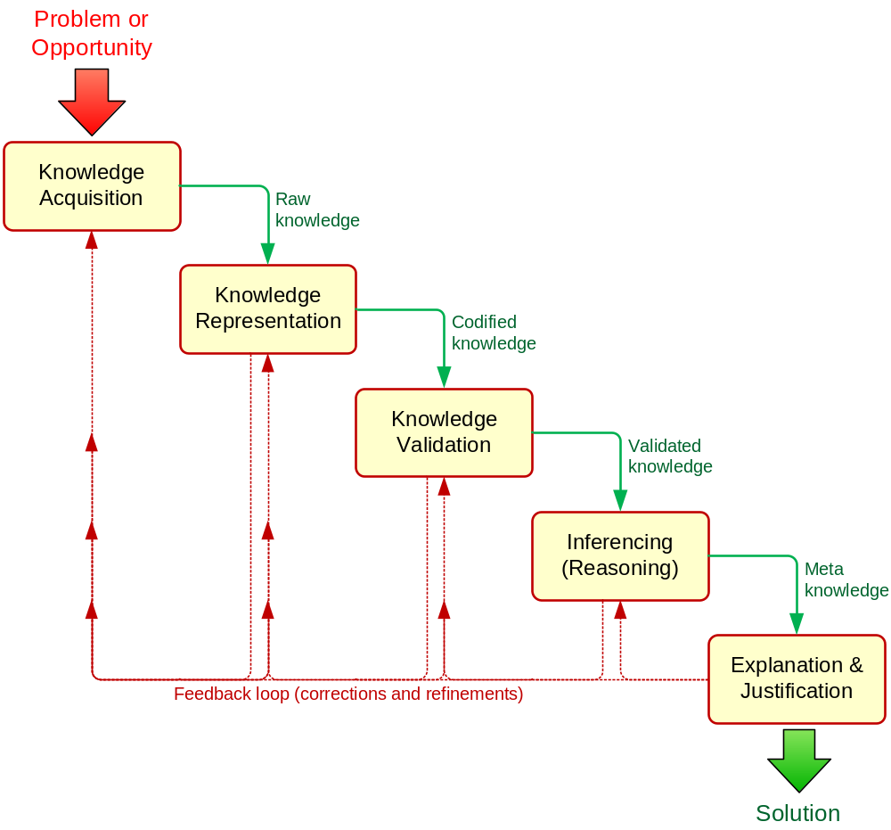
The Knowledge Engineering Process

Slide 27
Major Categories of Knowledge in ES
Declarative Knowledge
  Descriptive representation of knowledge that relates to a specific object.
  Shallow - Expressed in a factual statements
  Important in the initial stage of knowledge acquisition
Procedural Knowledge
  Considers the manner in which things work under different sets of circumstances
  Includes step-by-step sequences and how-to types of instructions
Metaknowledge
  Knowledge about knowledge

Slide 28
How ES Work:
Inference Mechanisms
Knowledge representation and organization
  Expert knowledge must be represented in a computer-understandable format and organized properly in the knowledge base
  Different ways of representing human knowledge include:
    Production rules (*)
    Semantic networks
    Logic statements

Slide 29
Forms of Rules
IF premise, THEN conclusion
  IF your income is high, THEN your chance of being audited by the IRS is high
Conclusion, IF premise
  Your chance of being audited is high, IF your income is high
Inclusion of ELSE
  IF your income is high, OR your deductions are unusual, THEN your chance of being audited by the IRS is high, ELSE your chance of being audited is low
More Complex Rules
  IF credit rating is high AND salary is more than $30,000, OR assets are more than $75,000, AND pay history is not "poor," THEN approve a loan up to $10,000, and list the loan in category "B.”

Slide 30
Knowledge and Inference Rules
Two types of rules are common in AI:
  Knowledge rules and Inference rules
Knowledge rules (declarative rules), state all the facts and relationships about a problem
Inference rules (procedural rules), advise on how to solve a problem, given that certain facts are known
Inference rules contain rules about rules (metarules)
Knowledge rules are stored in the knowledge base
Inference rules become part of the inference engine
Example:
  IF needed data is not known THEN ask the user
  IF more than one rule applies THEN fire the one with the highest priority value first

Slide 31
How ES Work:
Inference Mechanisms
Inference is the process of chaining multiple rules together based on available data
  Forward chaining
  A data-driven search in a rule-based system
  If the premise clauses match the situation, then the process attempts to assert the conclusion
  Backward chaining
  A goal-driven search in a rule-based system
  It begins with the action clause of a rule and works backward through a chain of rules in an attempt to find a verifiable set of condition clauses

Slide 32
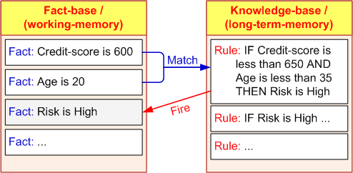
Inferencing with Rules:
Forward and Backward Chaining
Firing a rule
  When all of the rule's hypotheses (the “if parts”) are satisfied, a rule said to be FIRED
  Inference engine checks every rule in the knowledge base in a forward or backward direction to find rules that can be FIRED
  Continues until no more rules can fire, or until a goal is achieved

Slide 33
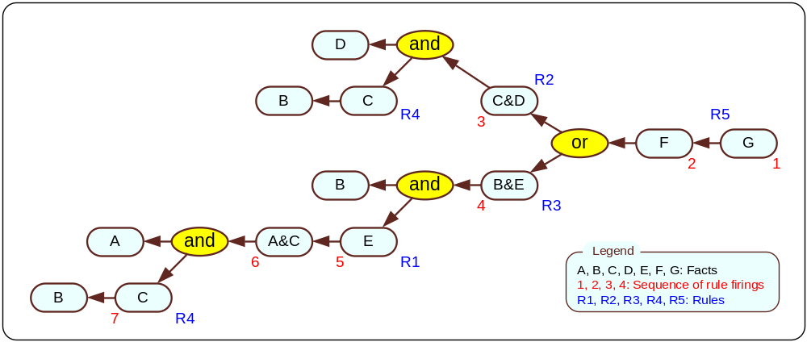
Backward Chaining
Goal-driven: Start from a potential conclusion (hypothesis), then seek evidence that supports (or contradicts with) it
Often involves formulating and testing intermediate hypotheses (or sub-hypotheses)
Investment Decision: Variable Definitions
  A = Have $10,000
  B = Younger than 30
  C = Education at college level
  D = Annual income > $40,000
  E = Invest in securities
  F = Invest in growth stocks
  G = Invest in IBM stock
Knowledge Base
Rule 1: A & C -> E
Rule 2: D & C -> F
Rule 3: B & E -> F (invest in growth stocks)
Rule 4: B -> C
Rule 5: F -> G (invest in IBM)

Slide 34

Forward Chaining
Data-driven: Start from available information as it becomes available, then try to draw conclusions
Which One to Use?
  If all facts available up front - forward chaining
  Diagnostic problems - backward chaining
Knowledge Base
Rule 1: A & C -> E
Rule 2: D & C -> F
Rule 3: B & E -> F (invest in growth stocks)
Rule 4: B -> C
Rule 5: F -> G (invest in IBM)
FACTS:
A is TRUE
B is TRUE

Slide 35
Inferencing Issues
How do we choose between BC and FC
  Follow how a domain expert solves the problem
    If the expert first collect data then infer from it
    => Forward Chaining
    If the expert starts with a hypothetical solution and then attempts to find facts to prove it => Backward Chaining
How to handle conflicting rules
  IF A & B THEN C
  IF X THEN C
  Establish a goal and stop firing rules when goal is achieved
  Fire the rule with the highest priority
  Fire the most specific rule
  Fire the rule that uses the data most recently entered

Slide 36
Inferencing with Uncertainty
Theory of Certainty (Certainty Factors)
Certainty Factors and Beliefs
Uncertainty is represented as a Degree of Belief
Express the Measure of Belief
Manipulate degrees of belief while using knowledge-based systems
Certainty Factors (CF) express belief in an event based on evidence (or the expert's assessment)
  1.0 or 100 = absolute truth (complete confidence)
  0 = certain falsehood
CFs are NOT probabilities
CFs need not sum to 100

Slide 37
Inferencing with Uncertainty
Combining Certainty Factors
Combining Several Certainty Factors in One Rule where parts are combined using AND and OR logical operators
AND
  IF inflation is high, CF = 50 percent, (A), AND
  unemployment rate is above 7, CF = 70 percent, (B), AND
  bond prices decline, CF = 100 percent, (C)
  THEN stock prices decline
  CF(A, B, and C) = Minimum[CF(A), CF(B), CF(C)]
  =>
  The CF for “stock prices to decline” = 50 percent
  The chain is as strong as its weakest link

Slide 38
Inferencing with Uncertainty
Combining Certainty Factors
OR
  IF inflation is low, CF = 70 percent, (A), OR
  bond prices are high, CF = 85 percent, (B)
  THEN stock prices will be high
  CF(A, B) = Maximum[CF(A), CF(B)]
  =>
  The CF for “stock prices to be high” = 85 percent
  Notice that in OR only one IF premise needs to be true

Slide 39
Inferencing with Uncertainty
Combining Certainty Factors
Combining two or more rules
  Example:
    R1: IF the inflation rate is less than 5 percent,
    THEN stock market prices go up (CF = 0.7)
    R2: IF unemployment level is less than 7 percent,
    THEN stock market prices go up (CF = 0.6)
  Inflation rate = 4 percent and the unemployment level = 6.5 percent
  Combined Effect
    CF(R1,R2) = CF(R1) + CF(R2)[1 - CF(R1)]; or
    CF(R1,R2) = CF(R1) + CF(R2) - CF(R1) × CF(R2)

Slide 40
Inferencing with Uncertainty
Combining Certainty Factors
Example continued…
Given CF(R1) = 0.7 AND CF(R2) = 0.6, then:
CF(R1,R2) = 0.7 + 0.6(1 - 0.7) = 0.7 + 0.6(0.3) = 0.88
Expert System tells us that there is an 88 percent chance that stock prices will increase
For a third rule to be added
CF(R1,R2,R3) = CF(R1,R2) + CF(R3) [1 - CF(R1,R2)]
R3: IF bond price increases THEN stock prices go up (CF = 0.85)
Assuming all rules are true in their IF part, the chance that stock prices will go up is
CF(R1,R2,R3) = 0.88 + 0.85 (1 - 0.88) = 0.982

Slide 41
Inferencing with Uncertainty
Certainty Factors - Example
Rules
R1: IF blood test result is yes
THEN the disease is malaria (CF 0.8)
R2: IF living in malaria zone
THEN the disease is malaria (CF 0.5)
R3: IF bit by a flying bug
THEN the disease is malaria (CF 0.3)
Questions
What is the CF for having malaria (as its calculated by ES), if
1. The first two rules are considered to be true ?
2. All three rules are considered to be true?

Slide 42
Inferencing with Uncertainty
Certainty Factors - Example
Questions
What is the CF for having malaria (as its calculated by ES), if
1. The first two rules are considered to be true ?
2. All three rules are considered to be true?
Answer 1
1. CF(R1, R2) = CF(R1) + CF(R2) * (1 – CF(R1)
= 0.8 + 0.5 * (1 - 0.8) = 0.8 – 0.1 = 0.9
2. CF(R1, R2, R3) = CF(R1, R2) + CF(R3) * (1 - CF(R1, R2))
= 0.9 + 0.3 * (1 - 0.9) = 0.9 – 0.03 = 0.93
Answer 2
1. CF(R1, R2) = CF(R1) + CF(R2) – (CF(R1) * CF(R2))
= 0.8 + 0.5 – (0.8 * 0.5) = 1.3 – 0.4 = 0.9
2. CF(R1, R2, R3) = CF(R1, R2) + CF(R3) – (CF(R1, R2) * CF(R3))
= 0.9 + 0.3 – (0.9 * 0.3) = 1.2 – 0.27 = 0.93

Slide 43
Explanation as a Metaknowledge
Explanation
  Human experts justify and explain their actions
  … so should ES
  Explanation: an attempt by an ES to clarify reasoning, recommendations, other actions (asking a question)
  Explanation facility = Justifier
Explanation Purposes…
  Make the system more intelligible
  Uncover shortcomings of the knowledge bases (debugging)
  Explain unanticipated situations
  Satisfy users’ psychological and/or social needs
  Clarify the assumptions underlying the system's operations
  Conduct sensitivity analyses

Slide 44
Two Basic Explanations
Why Explanations - Why is a fact requested?
How Explanations - To determine how a certain conclusion or recommendation was reached
  Some simple systems - only at the final conclusion
  Most complex systems provide the chain of rules used to reach the conclusion
Explanation is essential in ES
Used for training and evaluation

Slide 45
How ES Work:
Inference Mechanisms
Development process of ES
  A typical process for developing ES includes:
    Knowledge acquisition
    Knowledge representation
    Selection of development tools
    System prototyping
    Evaluation
    Improvement /Maintenance

Slide 46
Development of ES
Defining the nature and scope of the problem
  Rule-based ES are appropriate when the nature of the problem is qualitative, knowledge is explicit, and experts are available to solve the problem effectively and provide their knowledge
Identifying proper experts
  A proper expert should have a thorough understanding of:
    Problem-solving knowledge
    The role of ES and decision support technology
    Good communication skills

Slide 47
Development of ES
Acquiring knowledge
  Knowledge engineer
  An AI specialist responsible for the technical side of developing an expert system. The knowledge engineer works closely with the domain expert to capture the expert’s knowledge
  Knowledge engineering (KE)
  The engineering discipline in which knowledge is integrated into computer systems to solve complex problems normally requiring a high level of human expertise

Slide 48
Development of ES
Selecting the building tools
  General-purpose development environment
  Expert system shell (e.g., ExSys or Corvid)…
  A computer program that facilitates relatively easy implementation of a specific expert system
  Choosing an ES development tool
    Consider the cost benefits
    Consider the functionality and flexibility of the tool
    Consider the tool's compatibility with the existing information infrastructure
    Consider the reliability of and support from the vendor

Slide 49
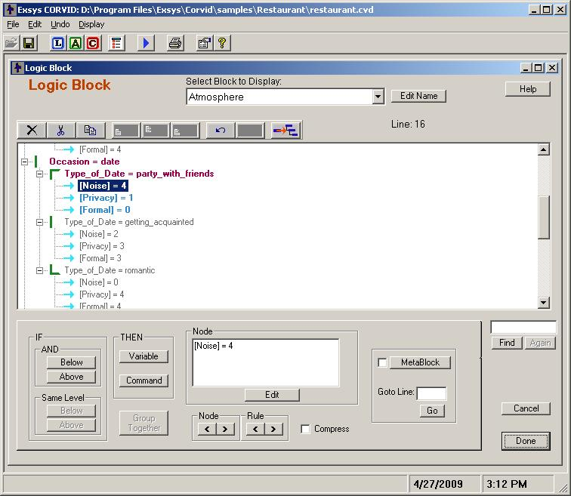
A Popular Expert System Shell

Slide 50
Development of ES
Coding (implementing) the system
  The major concern at this stage is whether the coding (or implementation) process is properly managed to avoid errors…
Assessment of an expert system
    Evaluation
    Verification
    Validation

Slide 51
Development of ES -
Validation and Verification of the ES
Evaluation
  Assess an expert system's overall value
  Analyze whether the system would be usable, efficient and cost-effective
Validation
  Deals with the performance of the system (compared to the expert's)
  Was the “right” system built (acceptable level of accuracy?)
Verification
  Was the system built "right"?
  Was the system correctly implemented to specifications?

Slide 52



Problem Areas Addressed by ES
Interpretation systems
Prediction systems
Diagnostic systems
Repair systems
Design systems
Planning systems
Monitoring systems
Debugging systems
Instruction systems
Control systems, …

Slide 53
ES Benefits
Capture Scarce Expertise
Increased Productivity and Quality
Decreased Decision Making Time
Reduced Downtime via Diagnosis
Easier Equipment Operation
Elimination of Expensive Equipment
Ability to Solve Complex Problems
Knowledge Transfer to Remote Locations
Integration of Several Experts' Opinions
Can Work with Uncertain Information
… more …

Slide 54
Problems and Limitations of ES
Knowledge is not always readily available
Expertise can be hard to extract from humans
  Fear of sharing expertise
  Conflicts arise in dealing with multiple experts
ES work well only in a narrow domain of knowledge
Experts’ vocabulary often highly technical
Knowledge engineers are rare and expensive
Lack of trust by end-users
ES sometimes produce incorrect recommendations
… more …

Slide 55
ES Success Factors
Most Critical Factors
  Having a Champion in Management
  User Involvement and Training
  Justification of the Importance of the Problem
  Good Project Management
Plus
  The level of knowledge must be sufficiently high
  There must be (at least) one cooperative expert
  The problem must be mostly qualitative
  The problem must be sufficiently narrow in scope
  The ES shell must be high quality, with friendly user interface, and naturally store and manipulate the knowledge

Slide 56
Longevity of Commercial ES
Only about 1/3 survived more than five years
Generally ES failed due to managerial issues
  Lack of system acceptance by users
  Inability to retain developers
  Problems in transitioning from development to maintenance (lack of refinement)
  Shifts in organizational priorities
Proper management of ES development and deployment could resolve most of them

Slide 57
An ES Consultation with ExSys
See it yourself…
Go to ExSys.com
Select from a number of interesting expert system solutions/demonstrations

Slide 58
End of the Chapter
Questions / comments…

Slide 59

All rights reserved. No part of this publication may be reproduced, stored in a retrieval system, or transmitted, in any form or by any means, electronic, mechanical, photocopying, recording, or otherwise, without the prior written permission of the publisher. Printed in the United States of America.
Copyright © 2011 Pearson Education, Inc.
Publishing as Prentice Hall

